Slide 1
Understanding Clouds
Shubham Arora, Michael Brunsam, and David Henderson
Sprint 1

Slide 2
Product Mission
The goal of this project is to create a program (in python) that takes in images of clouds, and can identify the different types of clouds present in the picture. Using this program, researchers can see how the types of clouds in a region have changed, and how the clouds are affected by climate change.

Slide 3
Customers/Users
The main intended user for this product are researchers/meteorologist researching climate change. There’s a lot of research being done on the effects of climate change on clouds. This product will help researchers study clouds in different regions using satellite imaging.

Slide 4
User Stories
I, the researcher, should be able to use this program to see the effects of climate change in a region.
I, the researcher, should be able to use this program to see what types of clouds are in a region.
I, the researcher/meteorologists, should be able to use this program to predict weather in a region.

Slide 5
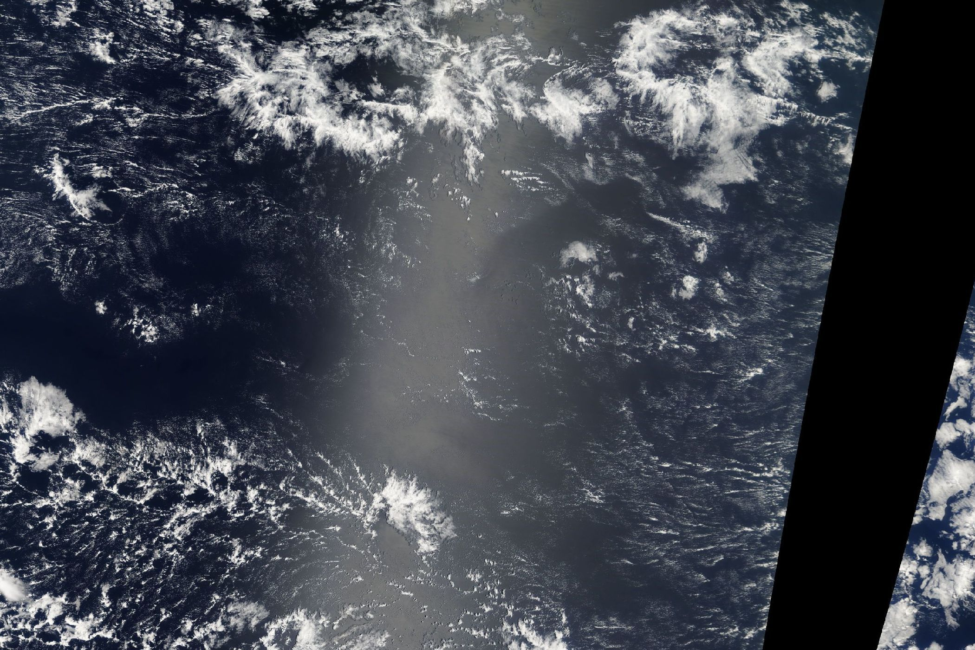
Example of Satellite Image

Slide 6
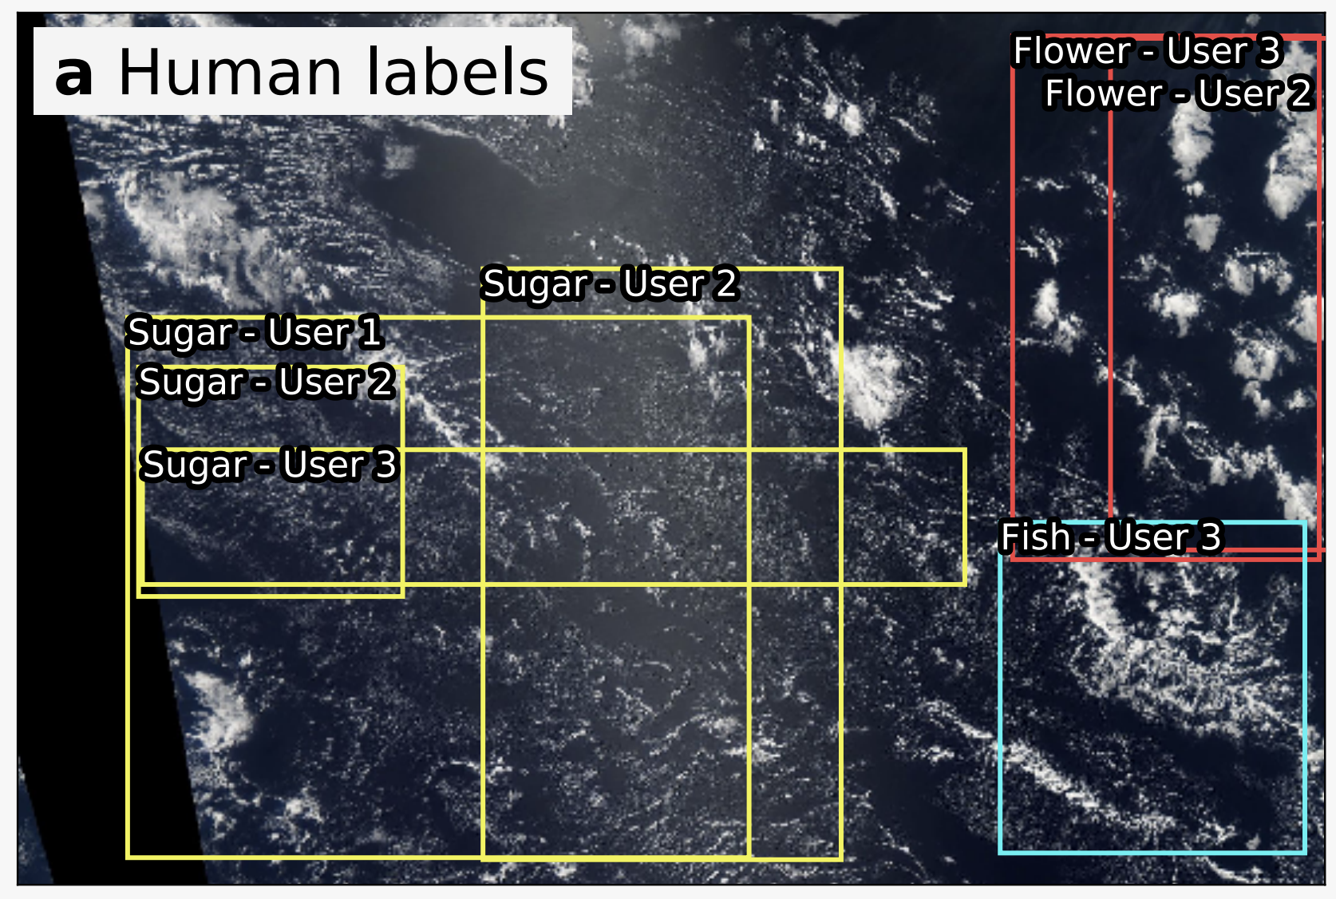
Example of Analysis

Slide 7
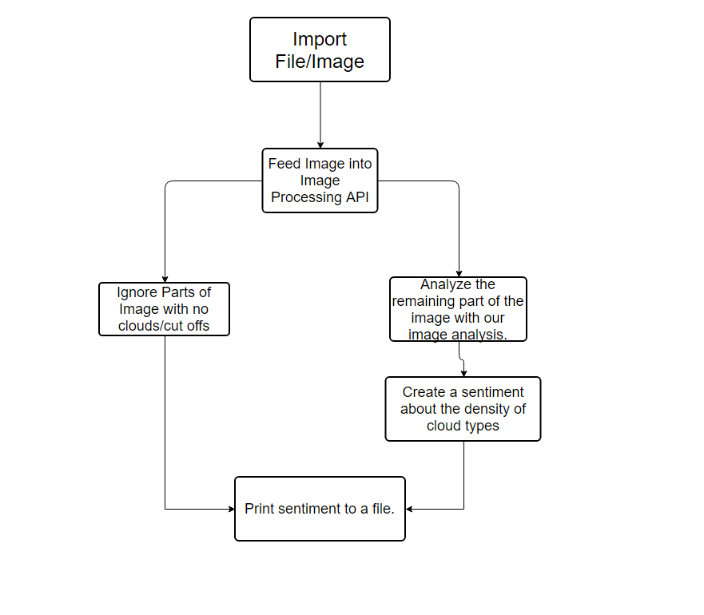
Implementation Path

Slide 8
Minimum Valuable Product
Our MVP’s bare bone features would be able to take in a satellite image (or a folder full of such images), analyze each one using an image processing API (such as scikit-image), and then return a sentiment detailing the density of each cloud type.

Slide 9
Looking Forward
Decide which image processing API we are going to use.
Create a working image analyzer for cloud types/density.
Combine the API and our image analyzing program into one master program.
(Potentially) create a GUI for our program.

